Slide 1


Slide 2


Slide 3

Violence: is any act that causes injury or harm, intimidates or causes fear, and demeans or humiliates a person.

Slide 4
Gender-based Violence: violence involving men and women, in which the woman/female is usually the victim and which arises from unequal power relationships between men and women. <ILO South East Asia & Pacific Multidisciplinary Advisory Team, 1998> In other words, its violence committed in an intimate relationship.

Slide 5

Physical. Acts that include bodily harm. Beating, kicking, punching, burning, arm-twisting, arm twisting, etc.
Note: In over 95% of all domestic abuse violence, the man is the batterer/perpetrator.

Slide 6

Psychological: Refers to words or actions that destroy or harm a woman’s belief in herself. What it does is demean or disempower a woman; undermining her mental or emotional well-being. Humiliating remarks, public ridicule, intimidation, threats, forced imprisonment, isolation, instilling fear, stalking, “always checking up,” forced to witness injurly to pet, unfounded accusations, silent treatment.

Slide 7

Economic: withdrawal of financial support, maintaining total control of family finances, running up bills for which the victim is responsible for payment, forbidding employment/occupation.
Sexual: forcing the victim to do indecent acts, forced prostitution, withholding sex.

Slide 8
Treating the woman as a sexual object
Forcing the woman to watch obscene/indecent shows
NOTE: Whether the abuse is physical, psychological, sexual, or economic, the heart of the problem is always an imbalance of power. The abuser learns that coercion works! That violence could give him easy results.

Slide 9
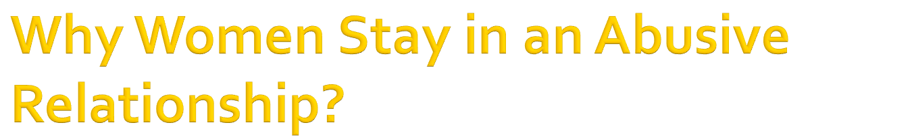
The man might change for the better
She still loves the man despite everything
She is doing it for the children (so as not to have a broken family)
She cannot support the children by herself
She is afraid of what the husband might do to her.
The husband might take the children
She “probably deserves the beating”

Slide 10

Economic dependence
Fear of greater physical danger/ suffering worse
Fear of emotional damage to children
Fear of losing custody of children
Lack of alternative housing and/or job skills
Social isolation
“Acceptable violence”
Ties to the community, her home, belongings
Family pressure

Slide 11

Insecurity. Afraid she can’t cope
Pity/ Fears he might commit suicide
Denial. “It’s really not that bad.”
Love. Especially during the “Honeymoon stage”.
Shame
Unfounded hopefulness. “Things will get better”
Learned helplessness.
Demolished self-esteem

Slide 12

Parenting. Needing a partner to raise kids.
Religious pressure. To keep family together no matter what.
Duty. I swore to stay married until death do us part.
Belief that marriage is forever
Responsibility. It’s up to her to work things out and save the relationship.

Slide 13

Believe that violence could give them easy results
Insecure. Extremely jealous and possessive
Emotionally dependent on their wives
Externalize blame for their actions
Have poor impulse control

Slide 14

Low self-esteem. Poor self image
Engage in internalization of traditional male roles (being the head)
Cannot translate their feelings into words, so they act it out.
Deny that they are violent.

Slide 15

They believe that violence done to them was their fault.
They fear for their lives as well as the lives of their children
They have irrational belief that the abuser is omnipotent
They are unable to place the responsibility for the violence elsewhere

Slide 16
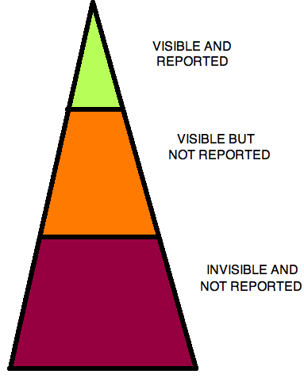


Slide 17
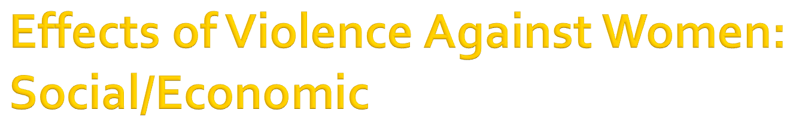
Lost working hours for the abused and their abusers
Pressure on health care system and other social services
Income loss for the abused breadwinner
Detrimental effects on school performance of abused children
Long term consequences of abuse. (intergenerational transmission)
Violation of human rights and policy of state.
Deters potential contribution to national development.
Economic costs on the victims like home displacement, legal costs, medical costs.

Slide 18
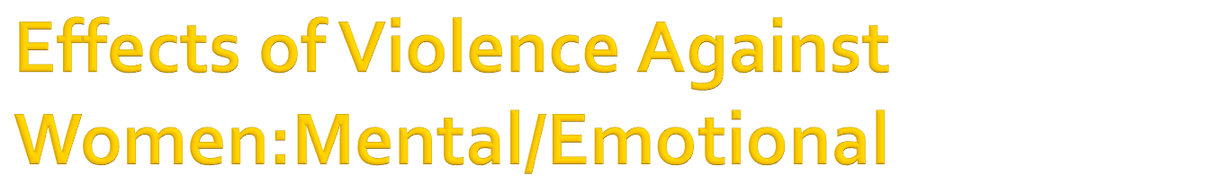
Fears, nervousness
Sleeping disorders (nightmares, insomnia)
Depression, nervous breakdown, suicidal attempts (tulala, nasisiraan ng bait)
Shame, guilt, self-blaming, loss of self-esteem and confidence
Relationship among family members is affected, especially the victim of abuse.

Slide 19

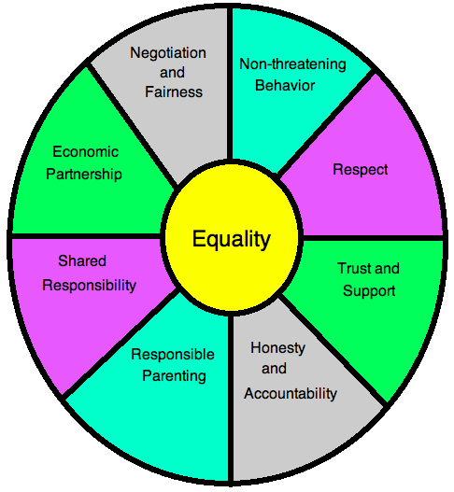

Slide 20

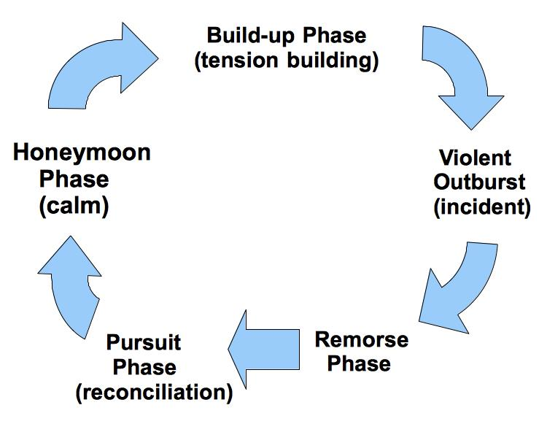
By Lenore
Walker

Slide 21
-Tension building.
    Tension is increased.
    Breakdown of communication
    Victim becomes fearful and feels the need to pacify the abuser.
-Incident. Verbal, physical, threats, blaming.
-Reconciliation.
    Abuser apologizes, gives excuses
    Blames victim
    Says it wasn't as bad as the victim claims
-Calm Incident is forgotten (“Honeymoon” phase)

Slide 22

Denial. The victim refuses to admit… she may call each incident an “Accident”.
Guilt. She new acknowledges there’s a problem, but considers herself responsible for it.
Enlightenment. She no longer assumes responsibility for her husband’s abusive behavior/treatment. She recognizes that she does not deserve to be beaten.
Responsibility. Accepts that her husband will not and cannot stop his violent behavior. The battered woman decides she will no longer submit to it and starts a new life.

Slide 23

Reinforce the victim’s self-esteem for her psychological healing. Identify positive traits and coping mechanisms that she has been using. Consider the following:
    Islamic Concept of Women
    Other Religious and social excerpts

Slide 24
B. If possible, make her aware of the available support systems.
C. Facilitate the opportunity and ability of the victim to independently regain control over her life. They should be taught some life skills

Slide 25
D. Encourage her to join religious groups for social support.
E. Women, especially the abused, should be educated about their rights and be taught to speak up if abused.

Slide 26
F. Be aware that during the ‘honeymoon’ stage, the victims may not be willing to discuss the abuse. Inform and describe to them about the cycle of abuse. There’s also a tendency that after each turn of a cycle, the violence can increase in frequency and severity
G. The victims should be given strategies for their own safety and that of their children’s such as avoiding confrontations in rooms where there is only one exit or rooms containing many potential weapons.

Slide 27

Notes:
Gentleman now the house is open for Question?
Q.1 What is the meaning of “IHSAN ?”
Ans: Linguistically this means perfection and excellence
Technically means to worship Allah as if you see Him, and if you can’t achieve this state then you must consider that he is seeing you
Q.2 You told that do Ihsan to Wayfarer what does this means
Ans: Actually wayfarer is your companion, when you are travel. Or in any journey Islam orders that behave with a gentle way or nice way with them

Slide 28


